Slide 1
Background Information:
Nicolae Ceausescu
Romanian Communist

Slide 2
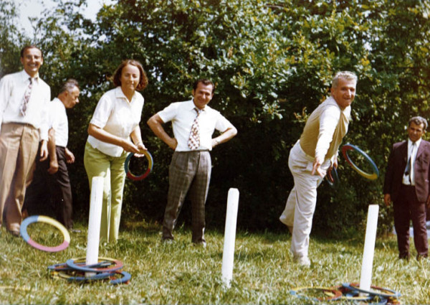
Family
-Born into a family of 10 children with little wealth on
January 26, 1918.
-Elena Petrescu, whom he married in 1946.
-Had 3 children: Valentin Ceausescu (born 1948),
a nuclear physicist;Nicu Ceausescu (1951–1996),
also a physicist; and a daughter, Zia Ceausescu
(1949–2006), who was a mathematician.
- At the age of 11, he ran away from his abusive
alcoholic father to Bucharest, initially living with
his sister, Niculina Rusescu.

Slide 3
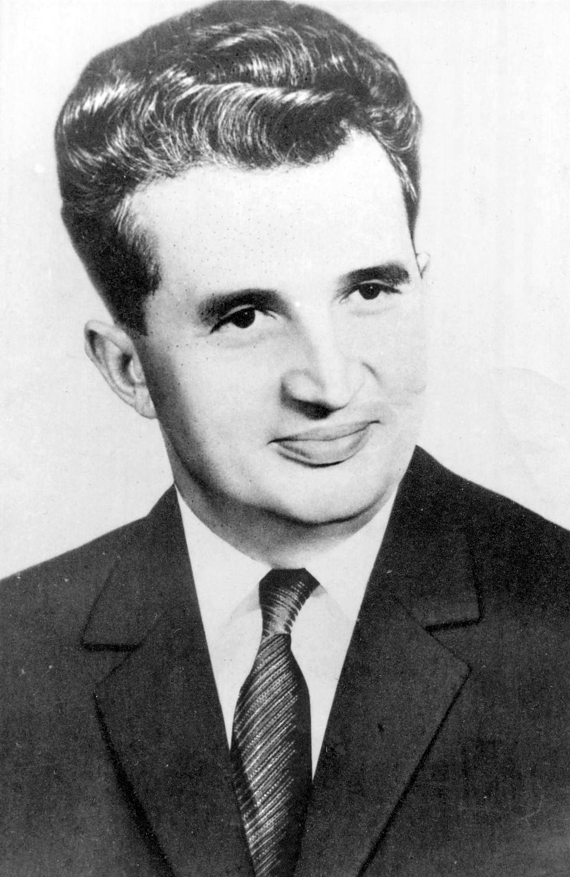
History of politics and careers
-In 1943, he was transferred to Targu Jiu Internment camp, where he shared a cell with Gheorghe Gheorghiu-Dej, becoming his protege.
-Ceausescu then went into politics because Gheorghiu-Dej who was in politics previously passed away and Ceausescu took over as General Secretary (1965 to 1989).
-Country's head of state from 1967 to 1989, 1967-1989 president of Romanian and member of the Romanian Communist youth movement.
-Ceausescu was a 2 star Lieutenant General.(1948)

Slide 4
Romanian Revolution
Ceausescu regime collapsed after he ordered his security forces to fire on anti-government demonstrators in the city of Timisoara on December 17, 1989. The demonstrators fled to Bucharest and became known as the Romanian Revolution. Demonstrations in the city of Timisoara were triggered by the government-sponsored attempt to evict Laszlo Tokes, an ethnic Hungarian pastor, accused by the government of inciting ethnic hatred. Mass meeting of December 21, held in what is now Revolution square. Ceausescu blamed the Timisoara riots on "fascist agitators who want to destroy socialism.” Roughly eight minutes into his speech, several people began jeering, booing and whistling at him a reaction that would have been unthinkable for most of the previous quarter-century of his rule. The rioters were no match for the military apparatus concentrated in Bucharest, which cleared the streets by midnight and arrested hundreds of people in the process. Ceausescu made a last desperate attempt to address the crowd gathered in front of the Central Committee building, but the people in the square began throwing stones and other projectiles at him, forcing him to take refuge in the building once more. They managed to overpower Ceausescu's bodyguards and rushed through his office. He, Elena and four others managed to get to the roof and escaped by helicopter. Regular military forces, police and Security fired on demonstrators, killing and injuring men, women and children. During the course of the revolution, the western press published estimates of the number of people killed by Securitate forces in attempting to support Ceausescu and quell the rebellion. The count increased rapidly until an estimated 64,000 fatalities were widely reported across front pages.

Slide 5
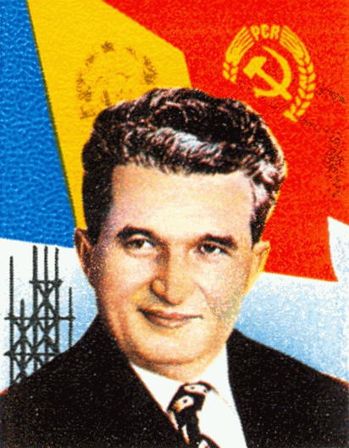
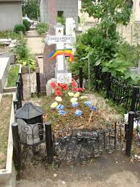
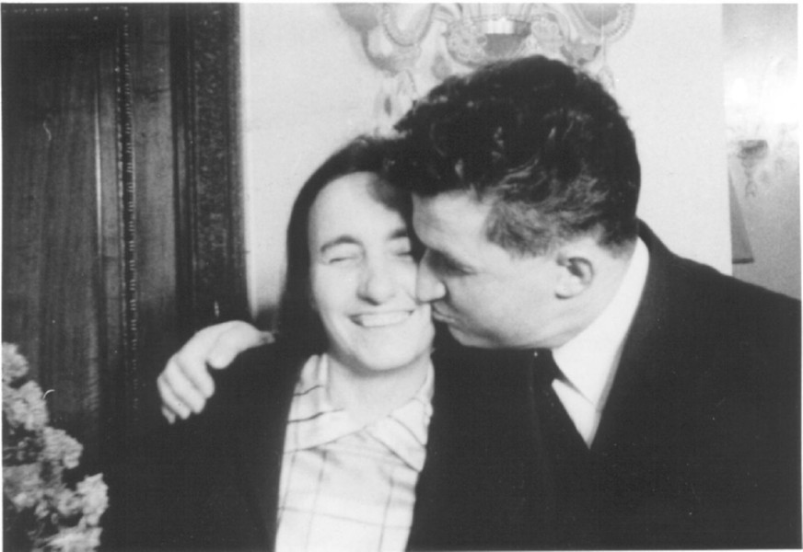
Nicolae Ceausescu’s Final Day
On Christmas Day Dec 25, 1989 Nicolae and Elena (wife) Ceausescu were charged with illegal gathering of wealth and genocide by the Drumhead court-martial. At the end of the quick trial the Ceausescus were found guilty and sentenced to death. A soldier was to take Ceausescu to a room where he was to be executed, Ceausescu demanded that he and his wife would be killed together. Nicolae and Elena Ceausescu were put on their knees and held hands, Nicolae Ceausescu began sing “the Internationale” while being led up against the wall. Both Ceausescus were executed and their bodies were covered by canvas. After Ceausescu’s death at the age of 71, hospitals across the country reported a death toll of less than 1,000, and probably much lower than that.

Slide 6
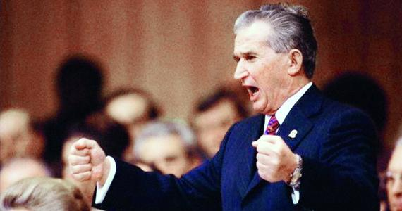
Quote
“You need not admit your mistakes, mister. In 1947,
we assumed power, but under completely different
circumstances. In 1947, King Michael showed
more dignity than you. And you might
perhaps have achieved the understanding
of the Romanian people if you had
now admitted your guilt.”
~Prosecutor Gica Popa

Slide 7
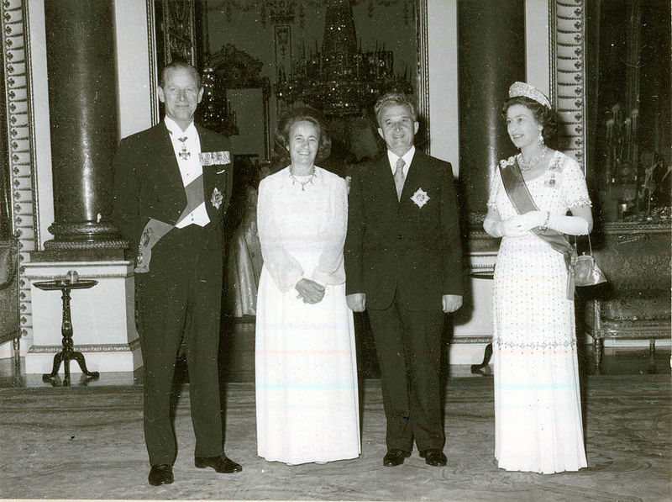
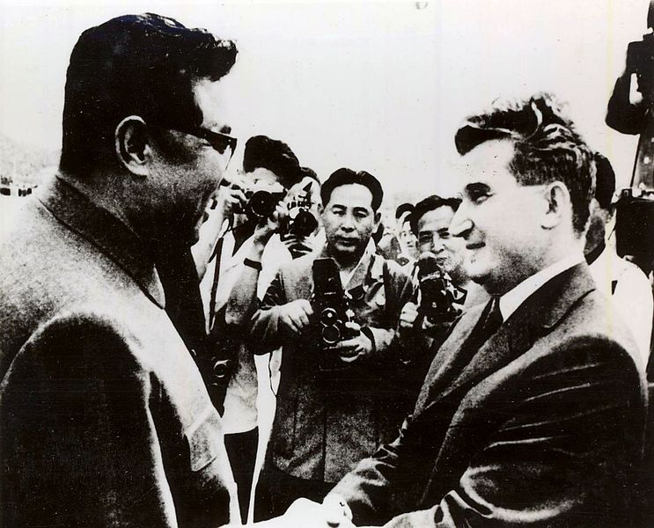
The presidential couple is received by Queen Elizabeth II at Buckingham Palace in June 1978.
Ceausescu meeting with North Korean leader Kim II Sung in 1971.

Slide 8
Work cited:
Unknown. “Nicolae Ceausescu.” Wikimedia Foundation. inc. Wikipedia. April 11, 2014. web. April 11, 2014.
Unknown. “Nicolae Ceausescu.” Encyclopaedia Britannica. Encyclopaedia Britannica online. Encyclopaedia inc. 2014. Web. April 14, 2014.
Unknown. “Trail of Nicolae and Elena Ceausescu.” Wikimedia Foundation inc. Wikipedia. April 2, 2014. Web. April 2, 2014.
Unknown. “Nicolae Ceausescu.” Wikiquote Inc. Wikipedia. June 29, 2013. Web. June 29, 2013.

