Slide 1
Human Rights Abuses: NGO Independent Novel Study
By: Jessica Patterson

Slide 2
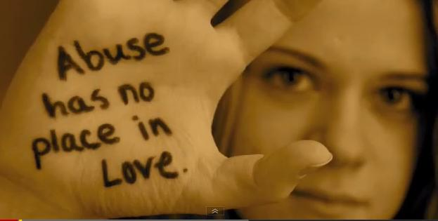
Women Against Abuse: http://www.womenagainstabuse.org/index.php/get-help
Article 16: (2) Marriage shall be entered into only with the free and full consent of the intending spouses.
“The only thing Baz’s mother were allowed to do were read the Bible to him or to clean the house. Baz was afraid to go out in case anything happened to her.” (Roger 83)
The services for Women Against Abuse would really help Baz’s mother, if she had access to a computer the website gives you tips on how to deal with the men in your life. It also warns you of some of the signs that tell you you’re in an abusive relationship. She could have called National Abuse Helpline and they could have suggested her the safest plan to end the marriage or relationship. (1-866-331-9474) The website also includes other resources such as counselling for women to cope with the abuse. Therefore, Baz’s mother could have had someone to talk to about what she was going through with her husband.

Slide 3
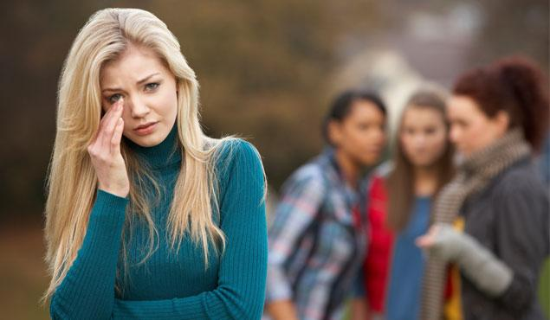
Kids Helpline-Teens: http://www.kidshelp.com.au/teens/
Article 1: All human beings are born free and equal in dignity and rights. They are endowed with reason and conscience and should act towards one another in a spirit of brotherhood.
“There was no one she could tell, there was nowhere she could go. That was when she ran away… She said she had sex with men to get money.” (Roger 233)
Kids Helpline could have really given Rosa a supporter, for all she has been through. All she had to do was call (1-800-668-6868) and the counsellor would have been
able to help Rosa get back on her feet. Rosa could have also been told by her
counsellor where a safe place to go was away from her family, instead of living on
the streets. The other thing with Kids
Helpline is that they are open to any calls
24/7. This would benefit Rosa to always
have someone to talk to whenever and
where ever.

Slide 4
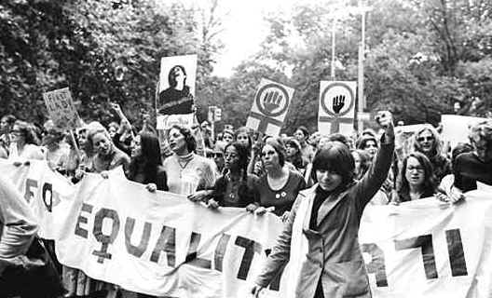
Women Empowerment Organization: http://www.weoiraq.org/
Article 2: Everyone is entitled to all the rights and freedoms set forth in this declaration, without distinction of any kind, such as race, colour, sex, language, religion, political or other opinion…
“She talked about the war against women. She said the introduction of MDS (Maternal Death Syndrome) is the logical outcome of thousands of years of men’s oppression and abuse of women.” (Roger 61)
“NO MORE SLEEPING BEAUTIES. NO MORE DEGRADATION OF WOMEN! Shouted one of the protestors.” (Roger 216)
The FLAME’s (Feminist Link Against Men) leader Gina should have used this organization to get her message across to the world. All you need to do it email your situation to info@weoiraq.com and they will have the event up on their website for locals to come, and join the empowerment of women. They also do advertising of conferences and other events on facebook to get the word out. This would have helped show the importance of equal rights and freedoms for women going through the MDS crisis.

Slide 5
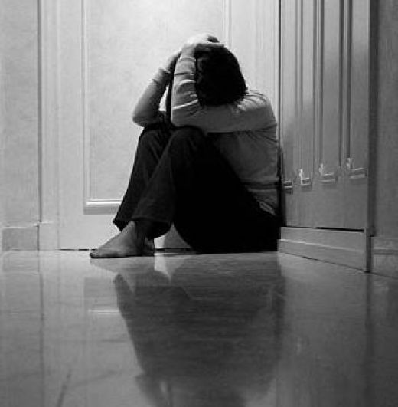
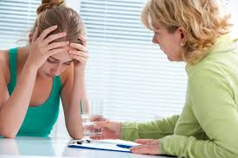
Rape Crisis: http://www.rapecrisis.org.uk/aboutus1.php
Article 5: No one shall be subjected to torture or to cruel, inhuman or degrading treatment or punishment.
“shall I call the police?”
“No.’ she gasped for breath again. ‘they raped me.”
(Roger 57)
Sal the one who was sexually assaulted, should have went onto Rape Crisis website. The site would have benefited Sal, they’re people who will talk to her about her situation. Just between you and your counselor, the National Rape helpline is (0808- 802- 9999). The site has a link that tells you how to cover up your tracks, since Sal doesn’t want anyone to know what happened. The website knows that you can not shake off a rape within a week or month, that’s why they have counselling. Sal could have gone to sessions to try and cope with her situation. The website provides a link to what you should do after being raped, and the steps you should go through to safely report your rape. Sal would have benefitted from these steps as she didn’t report her rape and didn’t find any closure.

Slide 6
Legal Information on issues related to violence against women: http://owjn.org/owjn_2009/legal-information/criminal-law/264-no-contact-orders--part-1-how-to-protect-yourself
Article 20: (2) No one may be compelled to belong to an association.
“There were allegations that clinics were tricking girls into volunteering; that money was
changing hands; even that girls were being kidnapped and drugged to take part in programmes.” (Roger 155)
This organization could have really helped the society of women, so that no woman was compelled to join the “Sleeping Beauties Programme.” The girl who felt threatened could go on the website to learn some of the steps for how you can protect yourself.
The site gives tips on how the legal system can help you, the
different types of protection and orders can asure
you will stay safe. To contact the organization for any
question the Direct Line is (416-392-3138).
This could have benefited many women at the time of MDS, and how
the law could have kept them safe.

